Slide 1
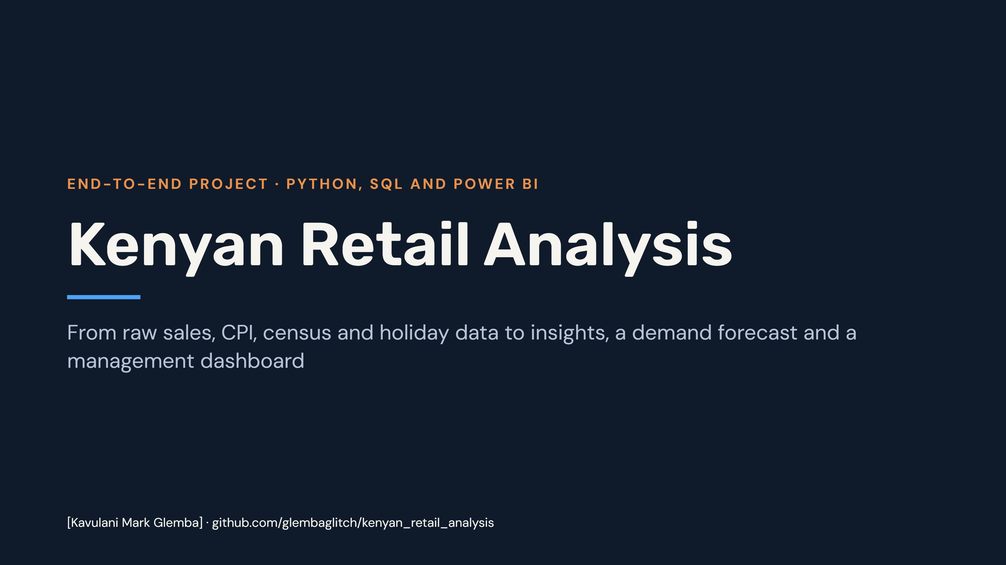
Notes:
This deck covers the whole project in the repository: the data, the cleaning and exploration in Python, the SQL analysis in PostgreSQL, the statistical tests, the demand forecast and the Power BI dashboard. Replace [Your name] before presenting.

Slide 2
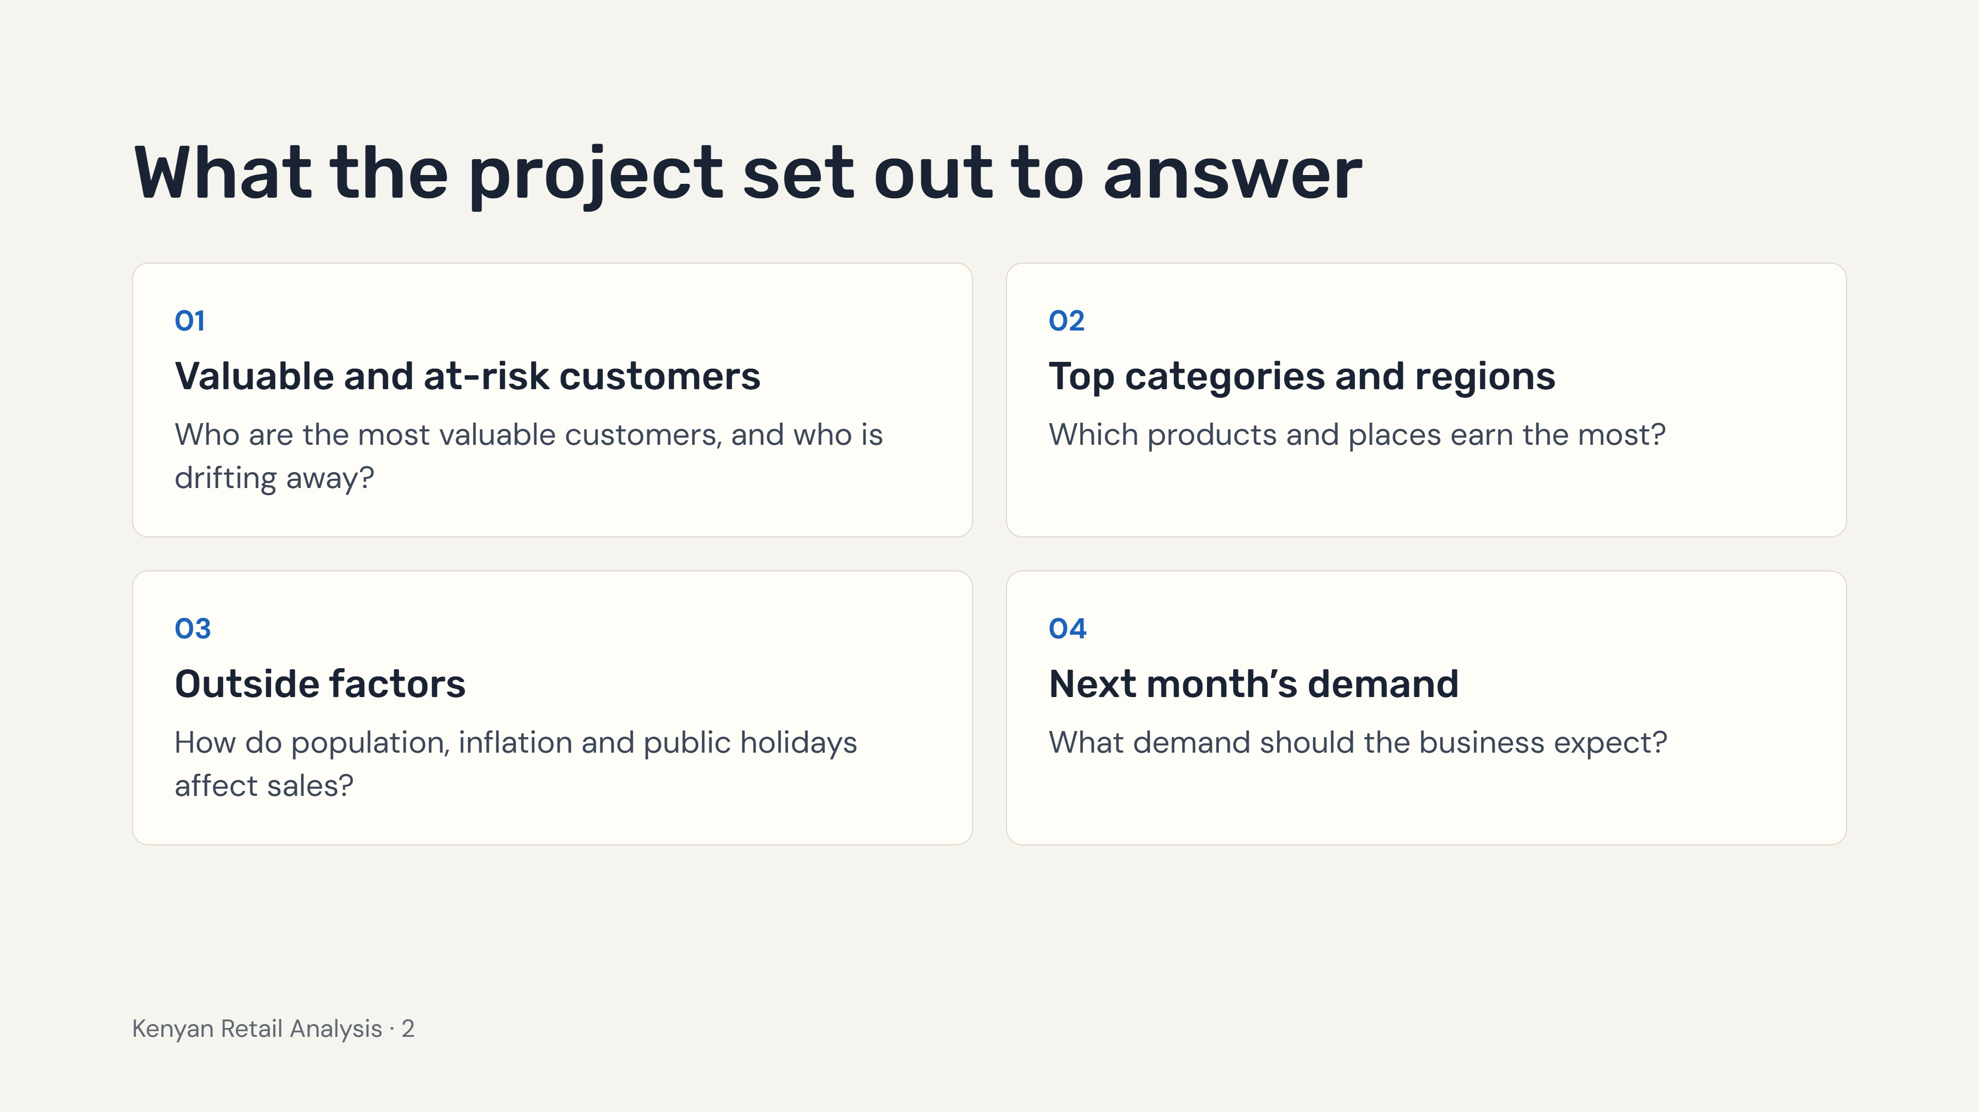
Notes:
These are the four business questions in the project README. The rest of the deck follows them: customers, products and places, outside factors, and the forecast.

Slide 3
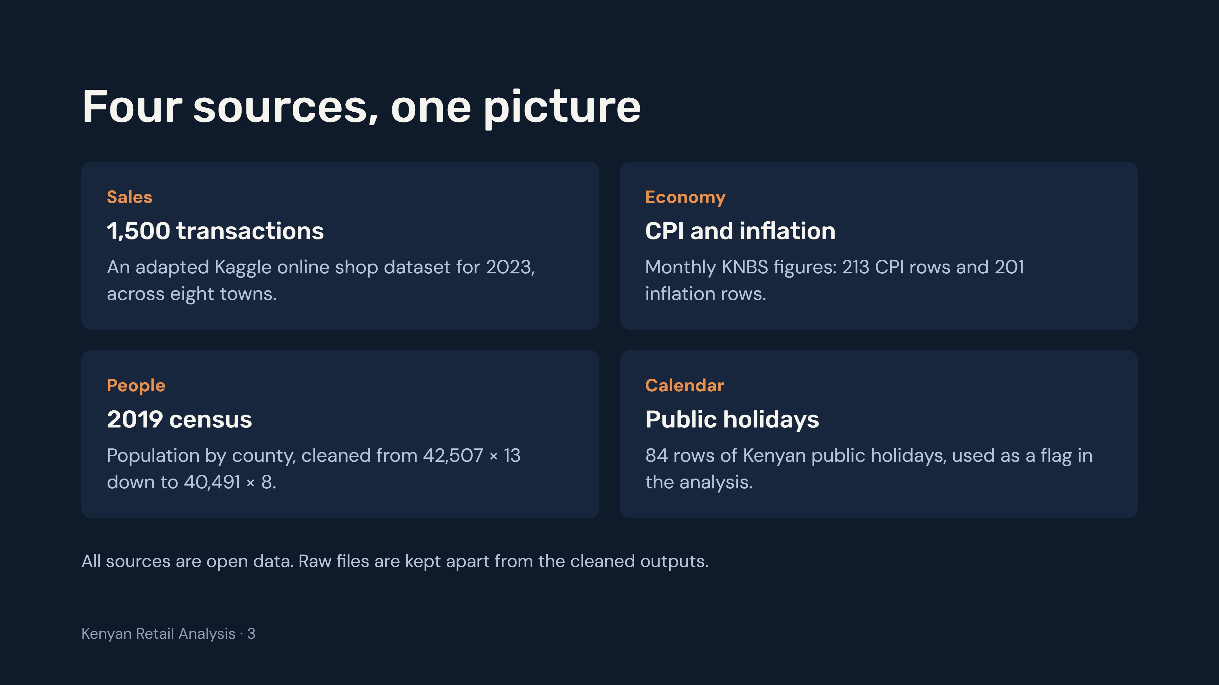
Notes:
Sales come from an adapted Kaggle online shop dataset. The economic data comes from the Kenya National Bureau of Statistics. Only the census file needed cleaning; the shop, CPI, inflation and holiday files were used as they were.

Slide 4
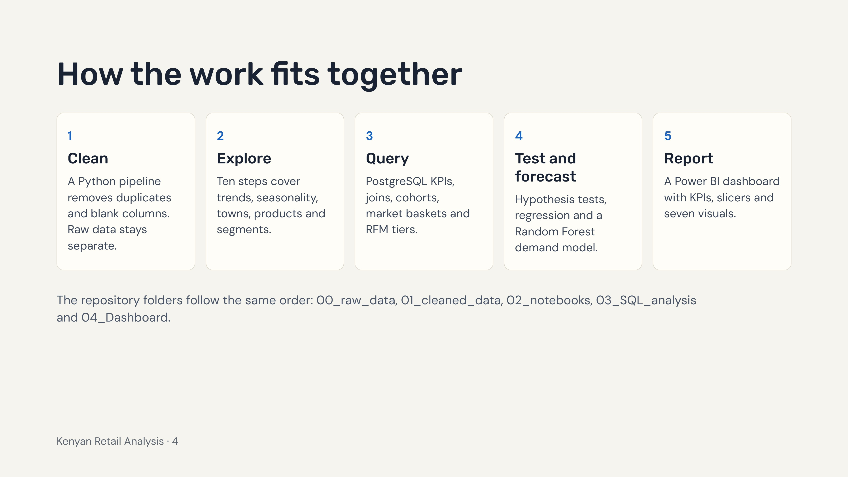
Notes:
Walk through the five stages left to right. Each stage has its own folder in the repository, so anyone can follow the work in order.

Slide 5
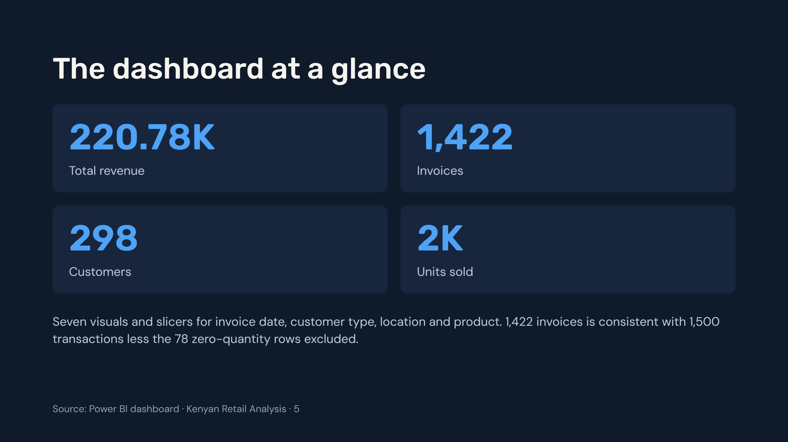
Notes:
These are the KPI cards on the Power BI report. The seven visuals are revenue by location, sales over time by customer type, customer-type share, price versus volume by product, revenue by product, monthly sales and an RFM treemap. The match between 1,500 transactions minus 78 excluded rows and 1,422 invoices is an inference, so confirm it in the cleaning notebook.

Slide 6
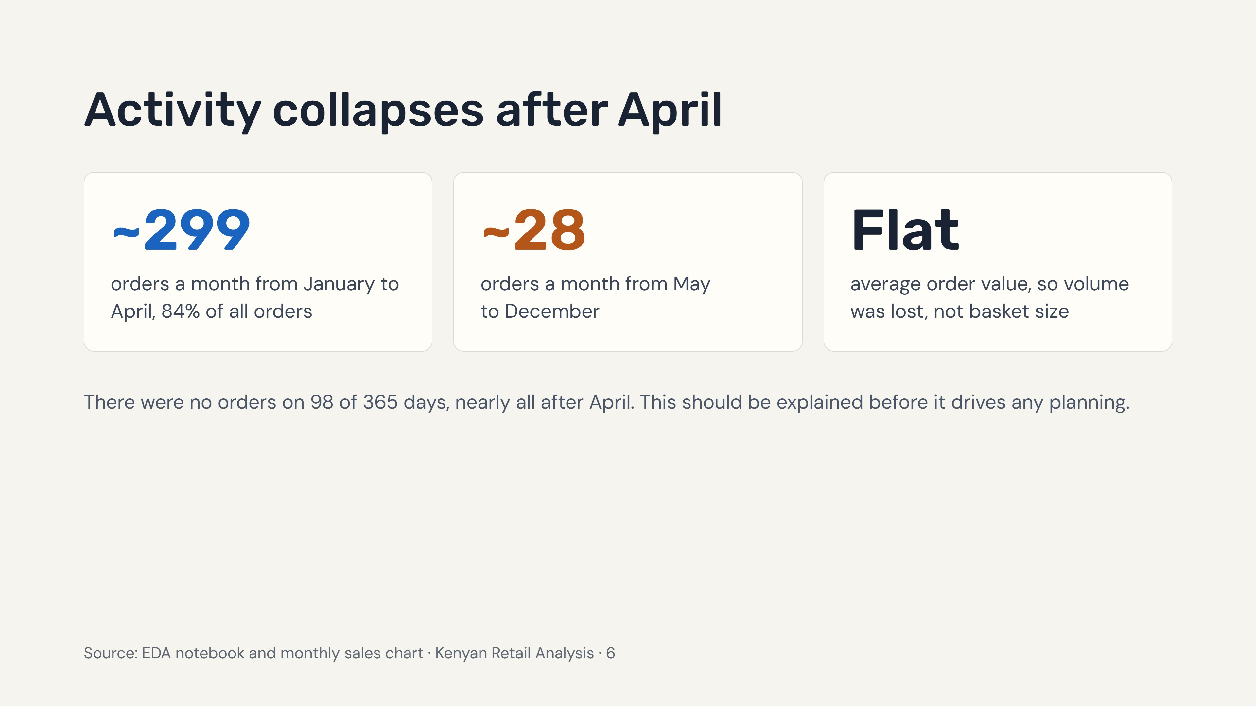
Notes:
This is the main pattern in the data and the one that shapes every other result. January to April holds 84% of orders, about 299 a month. From May to December it is about 28 a month. Average order value does not change, so customers did not start spending less per order; there were simply far fewer orders. Whether that is a real business change or a limit of the source dataset is still open.

Slide 7
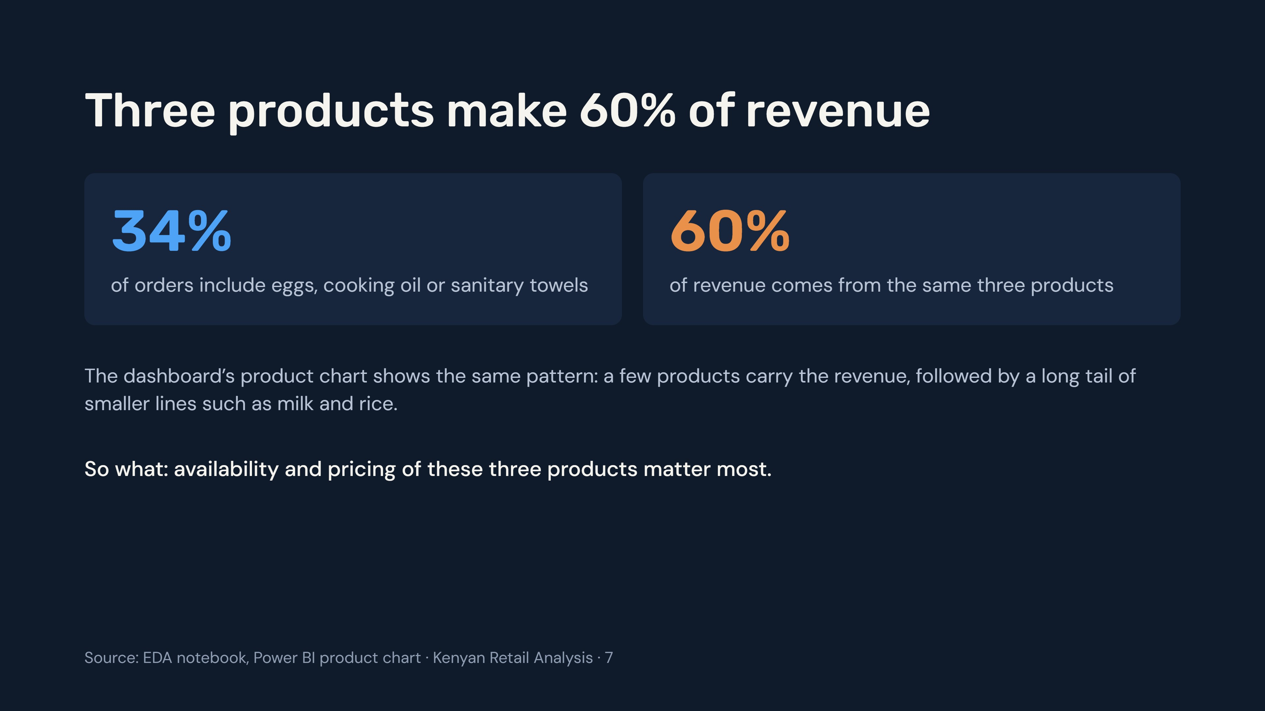
Notes:
The README reports that eggs, cooking oil and sanitary towels are 34% of orders but 60% of revenue. This replaces the earlier reading of the dashboard chart alone, which suggested bread was the third product. Use the README figures.

Slide 8
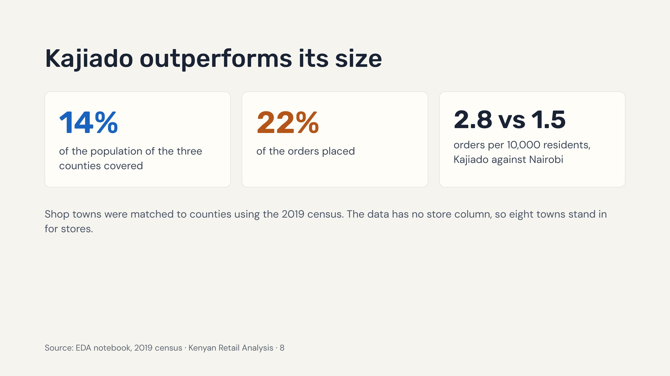
Notes:
Kajiado has 14% of the population of the three counties in the data but 22% of the orders. Per 10,000 residents that is 2.8 orders in Kajiado against 1.5 in Nairobi. Check the exact wording of the Nairobi comparison in the EDA notebook before presenting.

Slide 9
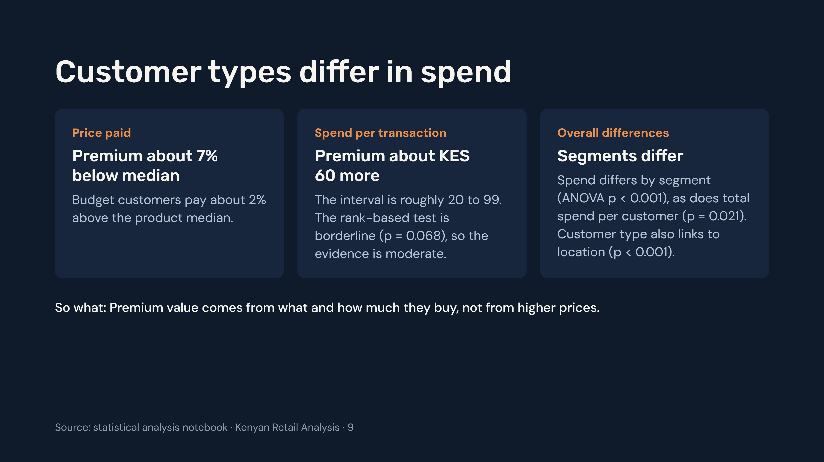
Notes:
Premium customers pay slightly less than the product median but spend about KES 60 more per transaction, so the extra spend must come from basket size or product mix. The mean difference is moderate evidence only because the rank-based test gives p = 0.068. Holidays, weekends and location showed no clear effect on transaction value.

Slide 10
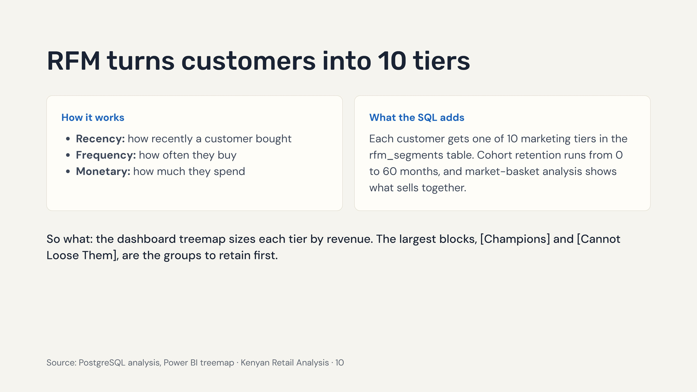
Notes:
RFM scoring and the 10 marketing tiers are built in the SQL analysis. Read the two largest segment names from the treemap in Power BI and put them into the last line before presenting.

Slide 11
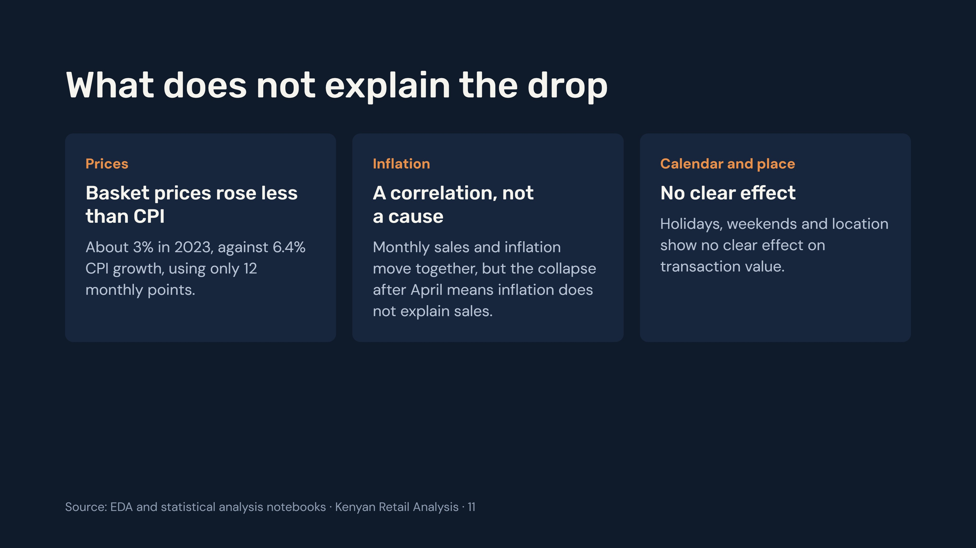
Notes:
The outside factors do not account for the fall in orders after April. Prices rose about 3% against 6.4% CPI growth, but that is based on only 12 monthly points. Holidays, weekends and location showed no clear effect on transaction value.

Slide 12
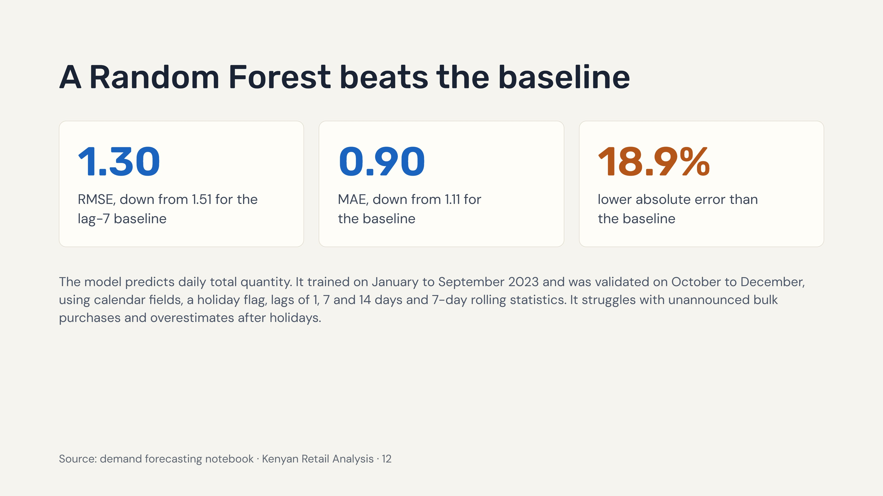
Notes:
Lower is better for both RMSE and MAE. The Random Forest improves on a simple baseline that repeats the value from seven days earlier. The validation window is only three months, so treat the result as a good start rather than proof.

Slide 13
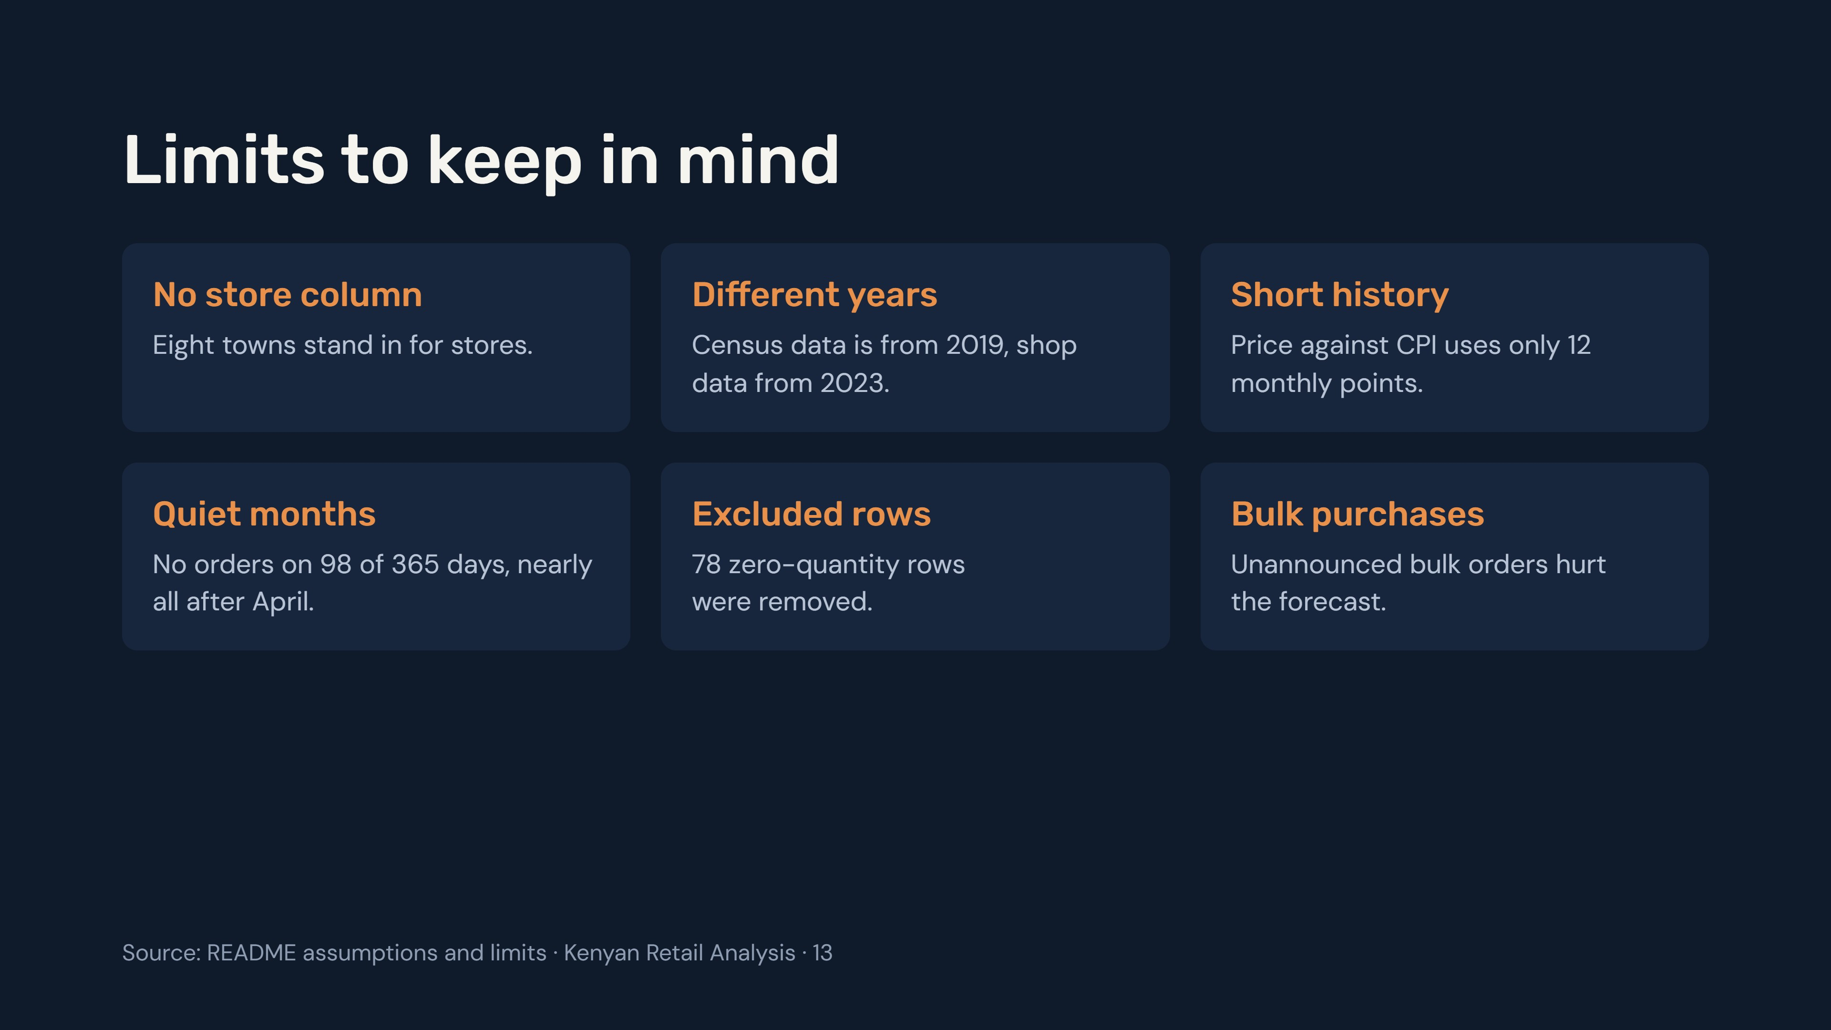
Notes:
These limits come from the assumptions listed in the README. They do not undo the findings, but they explain how much weight each one can carry.

Slide 14
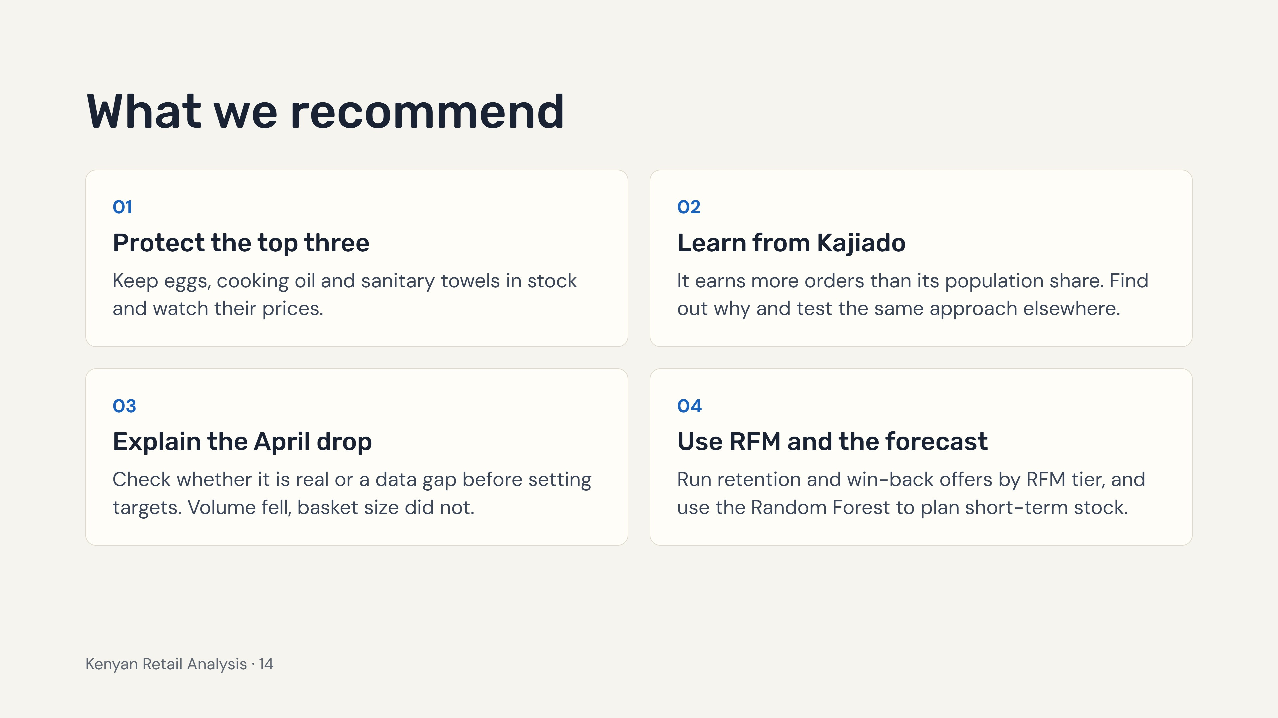
Notes:
The README has no recommendations section, so these follow from its findings. The third is deliberately a check before an action, because the April drop affects how far every other number can be trusted.

Slide 15
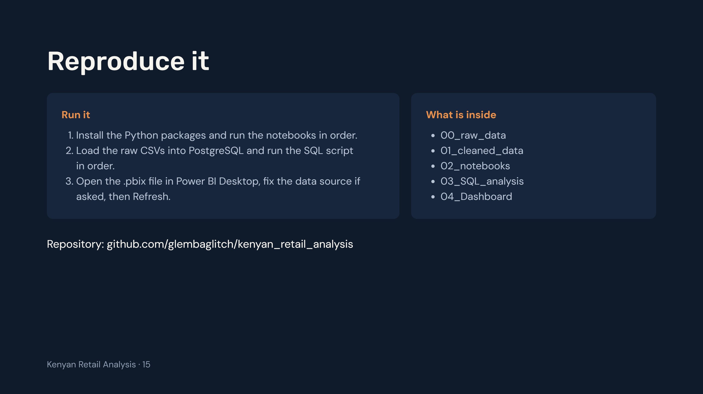
Notes:
Close by pointing people to the repository. The README has full run steps for the Python notebooks, the PostgreSQL scripts and the Power BI report.

